Slide 1

RUNGTA COLLEGE OF DENTAL SCIENCES & RESEARCH
TITLE OF THE TOPIC- INTRODUCTION TO ORTHODONTICS
DEPARTMENT OF ORTHODONTICS AND DENTOFACIAL ORTHOPAEDICS

Slide 2
Specific learning Objectives
CORE AREAS | DOMAIN | CATEGORY
DEFINITIONS | AFFECTIVE | DESIRE TO KNOW
HISTORY | COGNITIVE | MUST KNOW
UNFAVORABLE SEQUELA OF MALOCLUSSSION | COGNITIVE | MUST KNOW
AIMS | PSYCHOMOTOR | NICE TO KNOW
SCOPE | PSYCHOMOTOR | MUST KNOW
SERVICES OFFERED | PSYCHOMOTOR | NICE TO KNOW

Slide 3
Contents
Definitions
History
Unfavorable sequela of malocclusion
Aims
Scope
Services offered

Slide 4
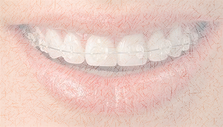
Definition of Orthodontics :
In 1911, Noyes
“the study of the relation of the teeth to the development of the
face, and the correction of arrested and perverted
development.”
British Society of Orthodontists proposed in 1922 that
“Orthodontics includes the study of growth and development of the jaws and face particularly, and the body generally, as influencing the position of the teeth; the study of action and reaction of internal and external influences on the development, and the prevention and correction of arrested and perverted development.”

Slide 5
Definition of Orthodontics :
Definitions by British Society of Orthodontists
The definition recognized the importance of growth but also associated it with etiology and the purpose of orthodontics to create and maintain a normal environment and proper physiologic activity of the teeth, the soft oral tissues, the facial and masticatory musculature, in order to ensure as far as possible optimum dentofacial development and function.
The use of the word prevention before correction symbolizes the need to diagnose a problem as soon as possible.

Slide 6
Definition of Orthodontics :
The definition of orthodontics proposed by the American Board of Orthodontics (ABO)
“Orthodontics is that specific area of the dental
profession that has as its responsibility the study and
supervision of the growth and development of the dentition
and its related anatomical structures from birth to dental
maturity, including all preventive and corrective procedures
of dental irregularities requiring the repositioning of teeth
by functional and mechanical means to establish normal
occlusion and pleasing facial contours.”
The American Board of Orthodontics’ definition recognizes the capability of the orthodontists in being able to change the profile by not only moving teeth but also by redirecting growth using functional appliances.

Slide 7
Definition of Orthodontics :
By Salzmann (1943)
‘a branch of science and art of dentistry which deals with
the developmental and positional anomalies of the teeth and
the jaws as they affect oral health and the physical, esthetic
and mental well being of the person.’

Slide 8

History of Orthodontics
Hippocrates (460-377 BC) was the first to draw attention towards the association of teeth to jaw structures.
In his writings are the lines “Among those individuals whose heads are long shaped, may have strongly arched palates, thus teeth are disposed to irregularity, crowding one on the other and they are molested by headaches and otorrhea.”
The first recorded method of treatment was that of
Celsius (125 BC-AD 50). He recommended that—“If a second tooth should happen to grow in children before the first has fallen out, that which ought to be shed is to be drawn out.”

Slide 9
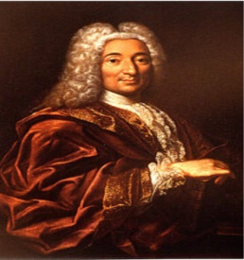
History of Orthodontics
The first mechanical treatment for correcting irregularities was suggested by Gaius Plinius Secundus (Pliny) (AD 23-79).
  He advocated the filing of elongated teeth to produce proper alignment.
Kneisel, in 1836, published the first book on malocclusion of the teeth. It was entitled, Der Schiefstand der Zahne.
Pierre Fauchard (1728) gave to the orthodontics the “bandelete” later known as the “expansion arch.”

Slide 10
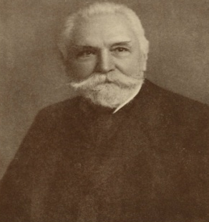
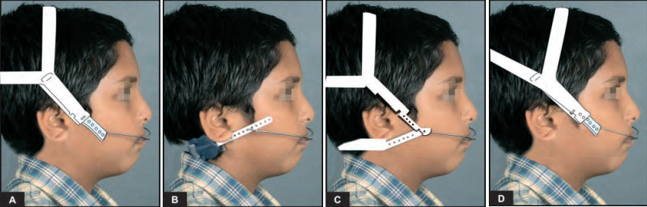
History of Orthodontics
Term orthodontia was used originally by Lefoulon in 1839.
In 1859, Norman William Kingsley presented the first obturator to a cleft palate patient and used extra oral elastics

Slide 11
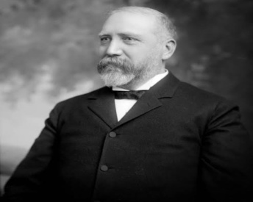
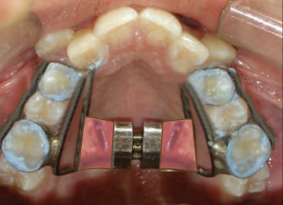
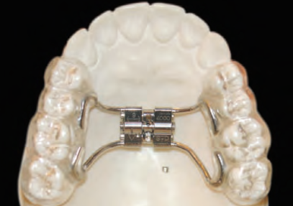
History of Orthodontics
The first outstanding work devoted exclusively to orthodontics was written by John Nutting Farrar (1839-1913) aptly titled—‘Treatise on Irregularities of the Teeth and their Correction.’
Emerson.C.Angell 1st advocated the opening of mid palatal suture known as RAPID MAXILLARY EXPANSION

Slide 12
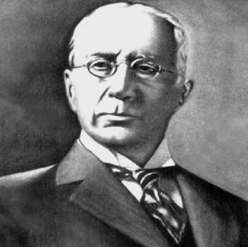
History of Orthodontics
In 1900, Edward H Angle (Father of Modern Orthodontics) started his first school of orthodontics in St. Luise.
  He developed the “E” arch,
  the pin and tube appliance,
  the ribbon arch appliance and the edge-wise appliance.
  was a proponent of the non-extraction school of thought

Slide 13
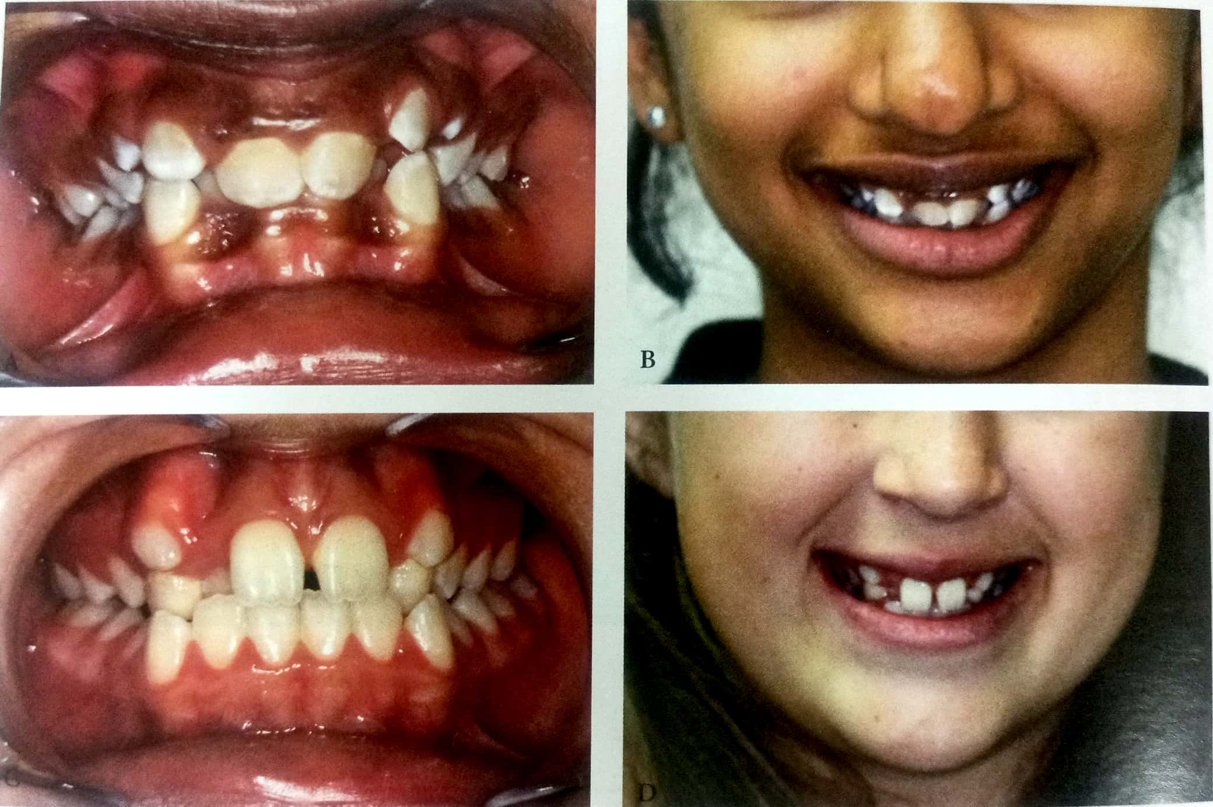
Unfavourable Sequela Of Malocclusion
1) Poor Facial Appearance:

Slide 14
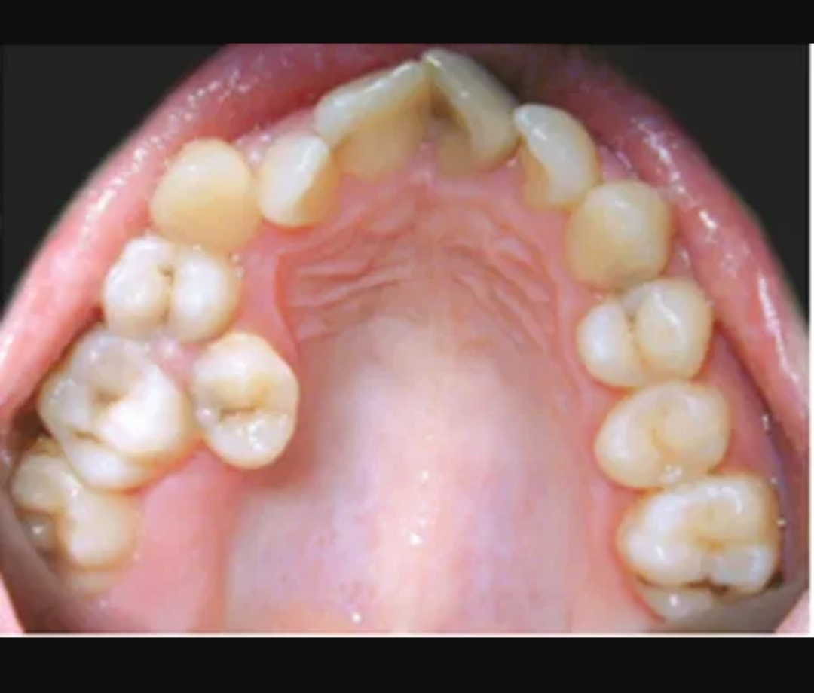
Unfavourable Sequela Of Malocclusion
2) Risk of Caries:
  Malalignment of teeth makes oral hygiene maintenance a difficult task
  Loss of interproximal tooth material due to untreated caries of primary molars or premature extraction of these teeth is associated with mesial migration of the permanent molars
  The consequence may be a shorting of the dental arch, crowding of the permanent dentition and alteration of antero posterior molar relationship.

Slide 15
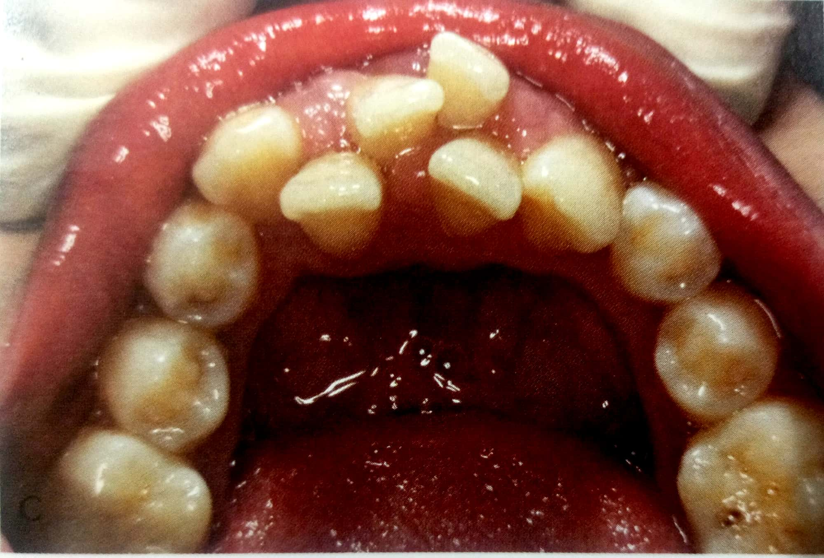
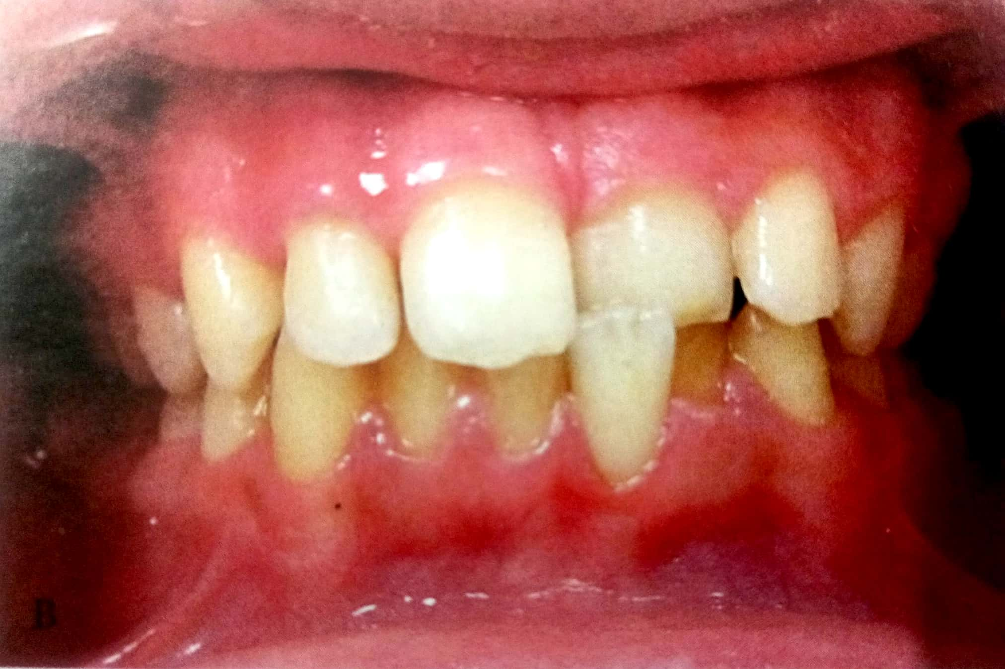
Unfavourable Sequela Of Malocclusion
3) Predisposition To Periodontal Diseases:
  Teeth that are placed in abnormal positions can be a cause for traumatic occlusion with resultant periodontal tissue damage.
  Traumatic overbite can also lead to increased loss of periodontal support and therefore are another indication for orthodontic treatment
  Crowding can cause one or more teeth being squeezed buccally or lingually out of their investing bone, resulting in reduced periodontal support

Slide 16
Unfavourable Sequela Of Malocclusion
4) Psychological Disturbances:
Malocclusion that adversely affect the appearances of the person leads to psychological disturbance. This makes a person highly self conscious and turns him into an introvert.
Thus treatment of malocclusion in such patients helps in improving the mental well being and confidence.

Slide 17
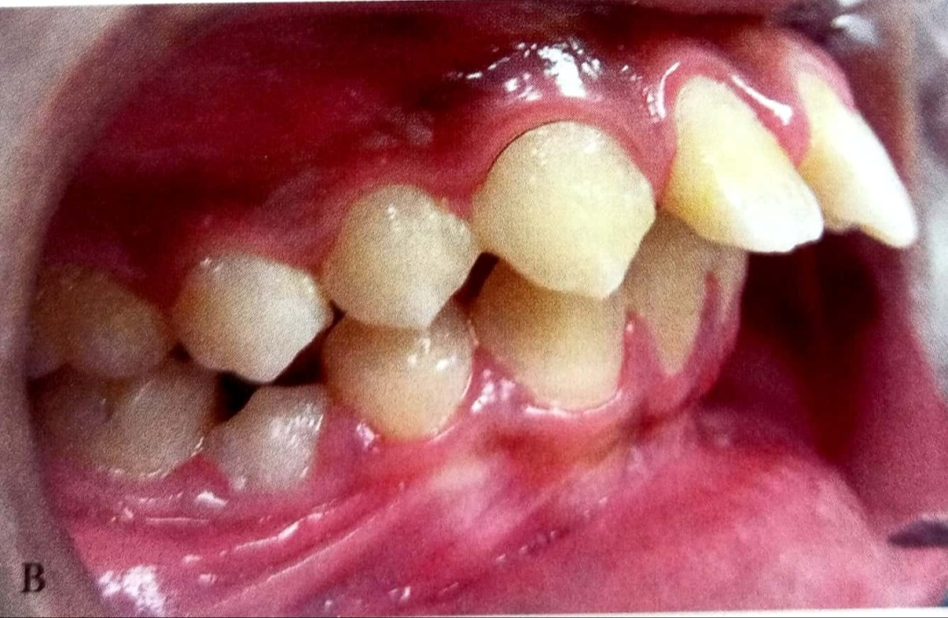
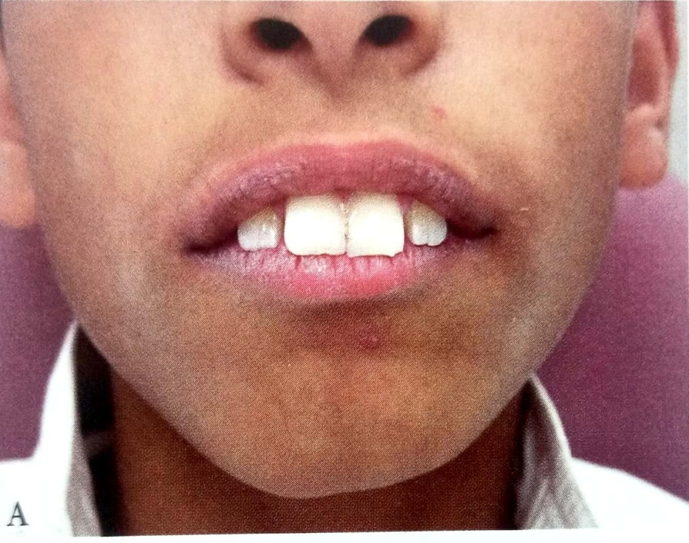
Unfavourable Sequela Of Malocclusion
5) Risk Of Trauma:
Teeth that are severely proclined are at a high risk of injury especially during play or accidental fall.
Studies have shown that overjets over 3mm have twice the risk of trauma to anterior teeth compare to those less than 3mm.

Slide 18
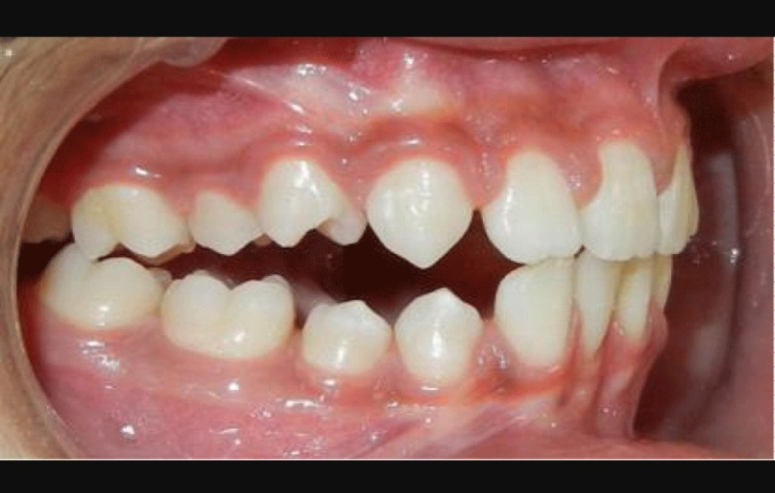
Unfavourable Sequela Of Malocclusion
6) Abnormalities Of Functions and TMDs
Many malocclusions cause abnormality in the functioning of the stomatognathic system such improper dilution ,defects in speech ,improper respiration etc.
Many malocclusion are associated with difficulty in biting and chewing e.g. Anterior open bite.

Slide 19
Aims Of Orthodontic Treatment
The aims and objectives of orthodontic therapy have been summarized by Jackson as Jackson’s Triad.
The three main objectives of
orthodontic treatment are:
a) Functional efficiency
b)Structural balance
c)Aesthetic harmony

Slide 20
A) Functional Efficiency:
The teeth along with their surrounding structures are required to perform certain important functions
The orthodontic treatment should thus aim at improving the functioning of the oro-facial apparatus
B) Structural Balance:
The oro-facial region consists of the dento-alveolar system, the skeletal tissue and the soft tissue including musculature.
Stable orthodontic treatment is best achieved by maintaining a balance between these three tissue systems.

Slide 21
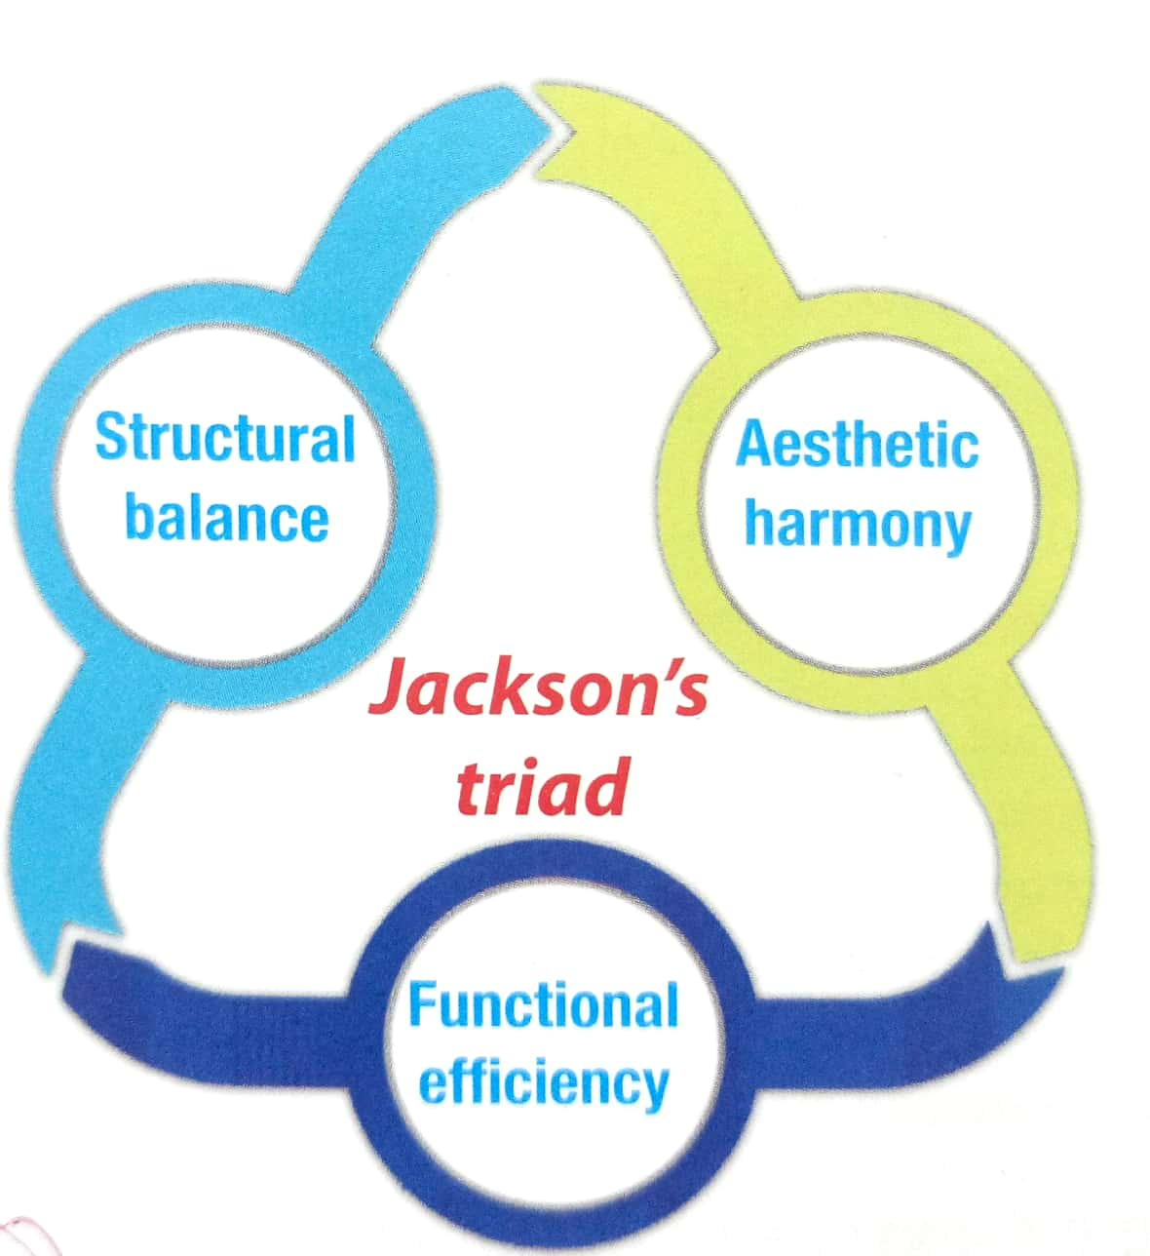
C) Aesthetic Harmony:
Many malocclusion are associated with unsightly appearance of the teeth and thus affect the individual self image, well being and success in society.
Thus orthodontic treatment should aim at improving the aesthetic of an individual

Slide 22
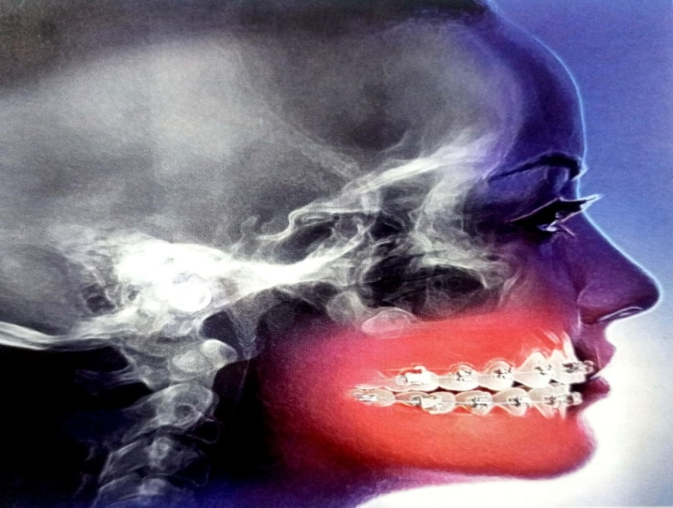
The Scope Of Orthodontic Treatment
Orthodontic treatment involves three main tissue system namely the dentition, the skeleton, the facial & the jaw musculature.
Orthodontic treatment can bring about changes in the dentition ,the skeletal system and the enveloping soft tissue

Slide 23
A) Alteration In Tooth Position:
Orthodontic treatment is made possible by the fact that teeth can be moved through the bone to ideal locations by applying appropriate force on them .
Most malocclusion involving the dental system can be effectively treated by moving teeth so as to normalize the occlusion.
B) Alteration In Skeletal Pattern:
Malocclusion may be associated with skeletal disharmony involving the jaw bone.
Deviations from the normal can arise in size, position and relationship between these skeletal components.

Slide 24
It is within the scope of an orthodontics to apply appropriate orthopaedic forces that are capable of restraining, promoting or redirecting skeletal growth so as to normalize the skeletal system.
The orthodontist can bring about changes in three planes of spaces i.e. Saggital , transverse, and vertical.
C) Alteration In Soft Tissue Pattern:
The soft tissue that envelop the dentition are greatly influenced by placement of the dentition.
It is possible to bring about favourable changes in the soft tissue pattern by orthodontics treatment.

Slide 25
Services Offered By An Orthodontist
a) Preventive orthodontics
b) Interceptive orthodontics
c) Corrective orthodontics
d) Surgical orthodontics

Slide 26
Services Offered By An Orthodontist
A) Preventive Orthodontics:
Preventive orthodontics requires the ability to appraise normal dentofacial and general development and growth and the recognition of deviations from the normal.
It entails the elimination of deleterious local habits involving dentofacial structures;
the correction of general contributory causes, such as incorrect posture and
malnutrition;
the maintenance of tooth form by proper restoration of individual teeth;
timely removal of retained deciduous teeth;
use of space maintainers after premature loss of deciduous teeth,

Slide 27
Services Offered By An Orthodontist
B) Interceptive Orthodontics:
According American Association of Orthodontists,
“that phase of the science and art of orthodontics, employed to recognize and eliminate potential irregularities and malpositions in the developing dentofacial complex”.
This phase concentrates on improving environmental conditions to permit future
normal development. It includes
  caries control,
  anatomical dental restorations,
  space maintenance,
  transitory oral habit correction, and supervising the exfoliation of deciduous teeth.
Certain procedures under the preventive and interceptive orthodontic fields may overlap
Interception always recognizes the existence of a malocclusion or malformation whereas the prevention is aimed at preventing the malocclusion or malformation from occurring.

Slide 28
Services Offered By An Orthodontist
C) Corrective Orthodontics:
Orthodontic procedures undertaken to correct a fully established malocclusion.
D) Surgical Orthodontics:
The surgical orthodontic procedure are usually carried out to remove an etiologic factor or to treat very severe dento-facial deformity that cannot be treated by orthodontic therapy alone.

Slide 29
Summary
The vast possibilities of this science are unfolding, they are still emerging.
The basic difference is that the American school is continuing
with the improvement in fixed appliances whereas the European school concentrated more on the removable and functional appliances.
Now the world has become so small that contributors to this science are not restricted to regions and techniques.
Although it is better to work within one’s limit, one also learns from the experience of others

Slide 30
Thank you

